Slide 1
Weekly Report
Dian Hanifudin Subhi

Slide 2
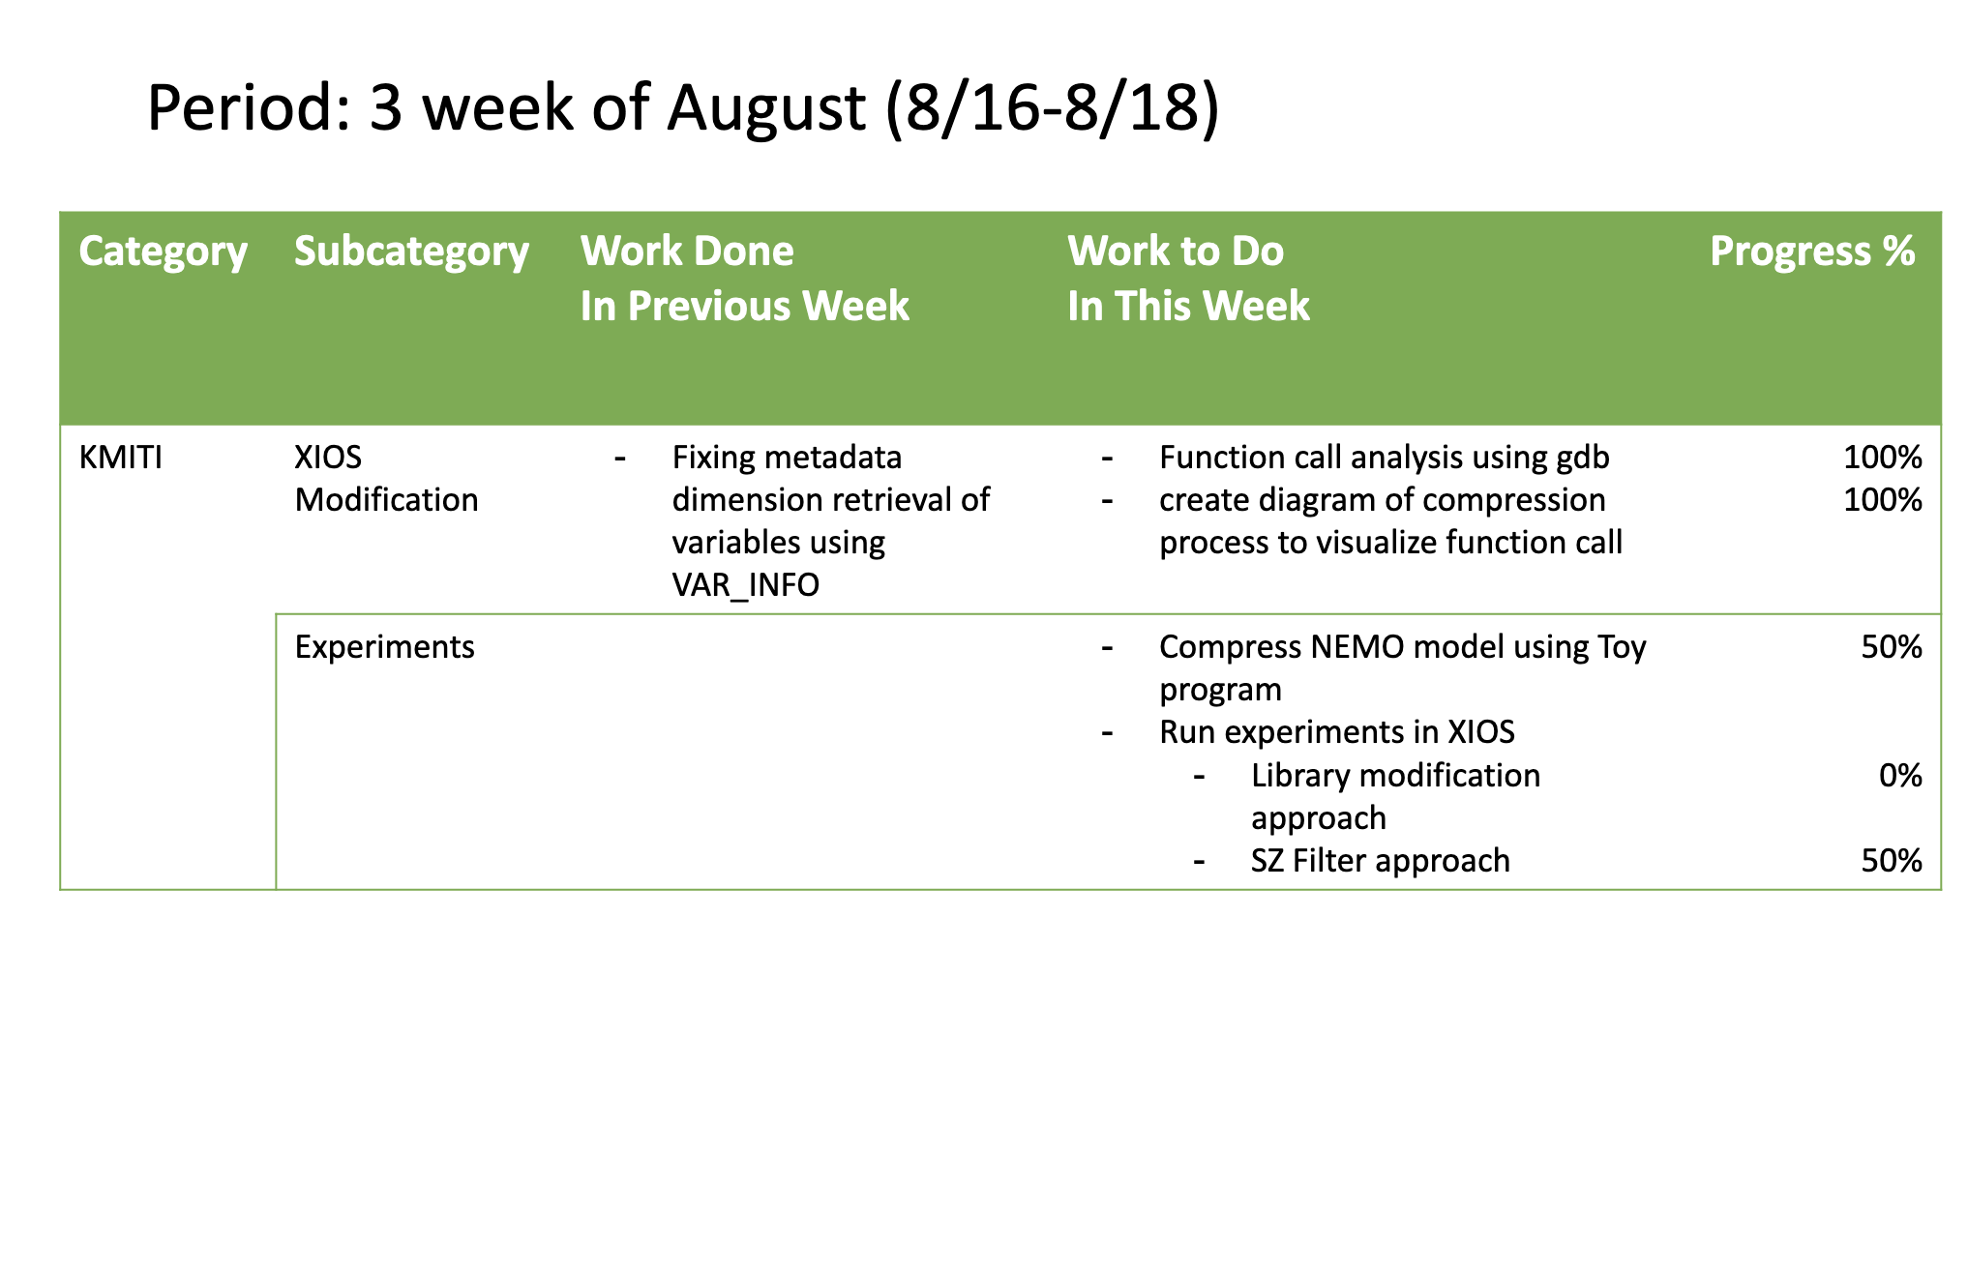
Weekly report

Slide 3
Summary of work this week
The current approach to performing SZ compression is by modifying the netCDF4+HDF5 library.
We have analyzed the function call when performing compression to find the alternative function that needs to be modified.
An alternative way to retrieve metadata needs to be tested.
The NetCDF source code provides NC_VAR_INFO and NC_DIM_INFO that store information regarding data type, and dimension length that is required to performing SZ_compress.
Code modification needs to be applied in libhdf5/nc4hdf.c instead of libhdf5/hdf5var.c.
The progress of SZ compression by modifying the netCDF4+HDF5 library
The metadata retrieval technique retrieved from VAR_INFO and DIM_INFO structs has been implemented.
The result is successful in the toy program for smaller dimensions (total multiplication of dimension length) using the NEMO model.
Experiments result in XIOS
The SZ filter experiment has been conducted in detach mode, the result is successful for the gsfc_model_m1_s01 task. However, the gsfc_ncdf_proc_m1_s01 task failed when merging the ocean model output.

Slide 4
XIOS Modification
GDB Function Call Analysis Preparation
GDB (GNU Debugger) is open-source debugging tool to debug programs written in C and C++.
GDB required the program compiled with the info symbol enabled.
The info symbol can be enabled by passing the -g flag for CFLAGS.
Recompilation of the libraries related to Low GloSea6 is required:
NetCDF4
HDF5
SZ

Slide 5
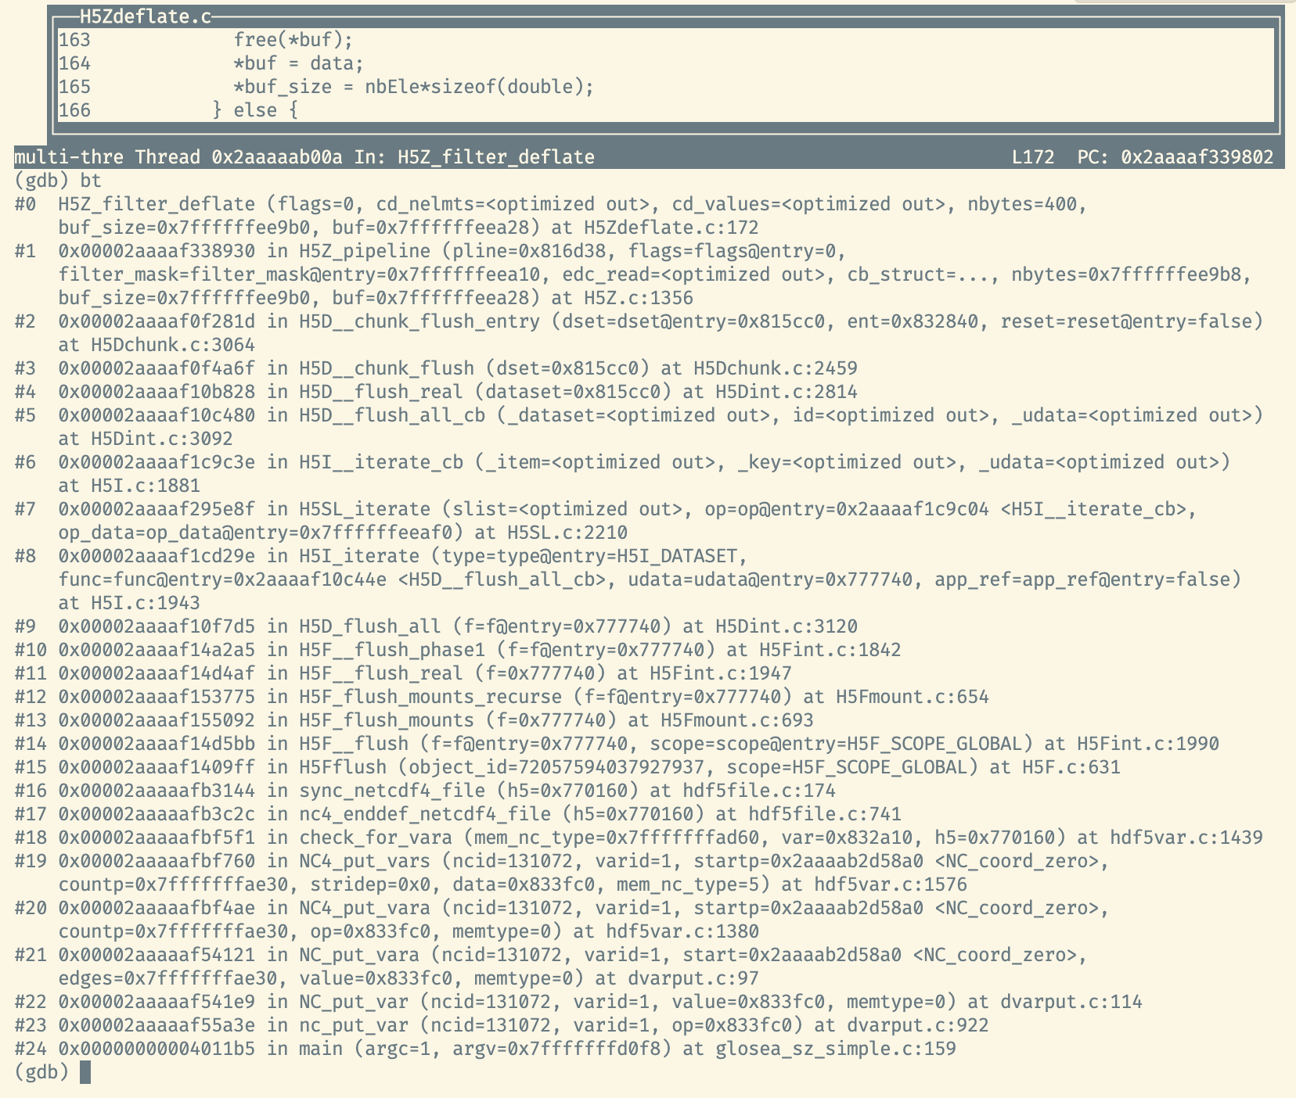
XIOS Modification
GDB Function Call Analysis

Slide 6
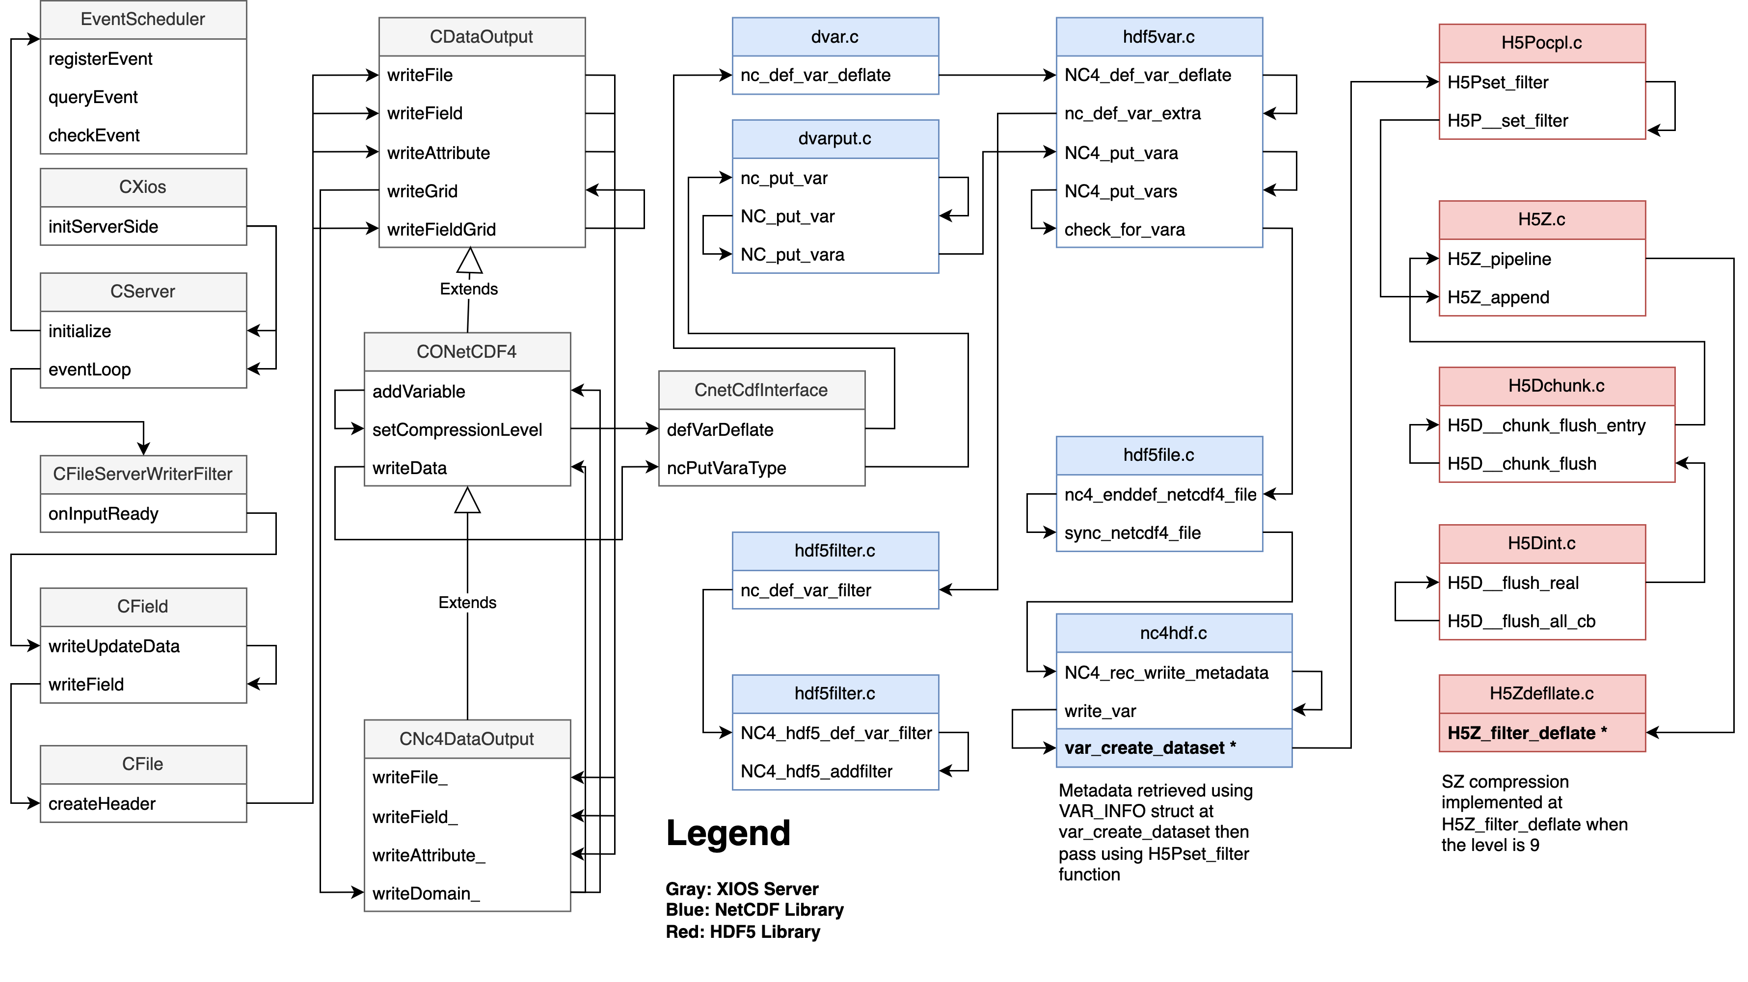
XIOS Modification
Function Call Diagram

Slide 7
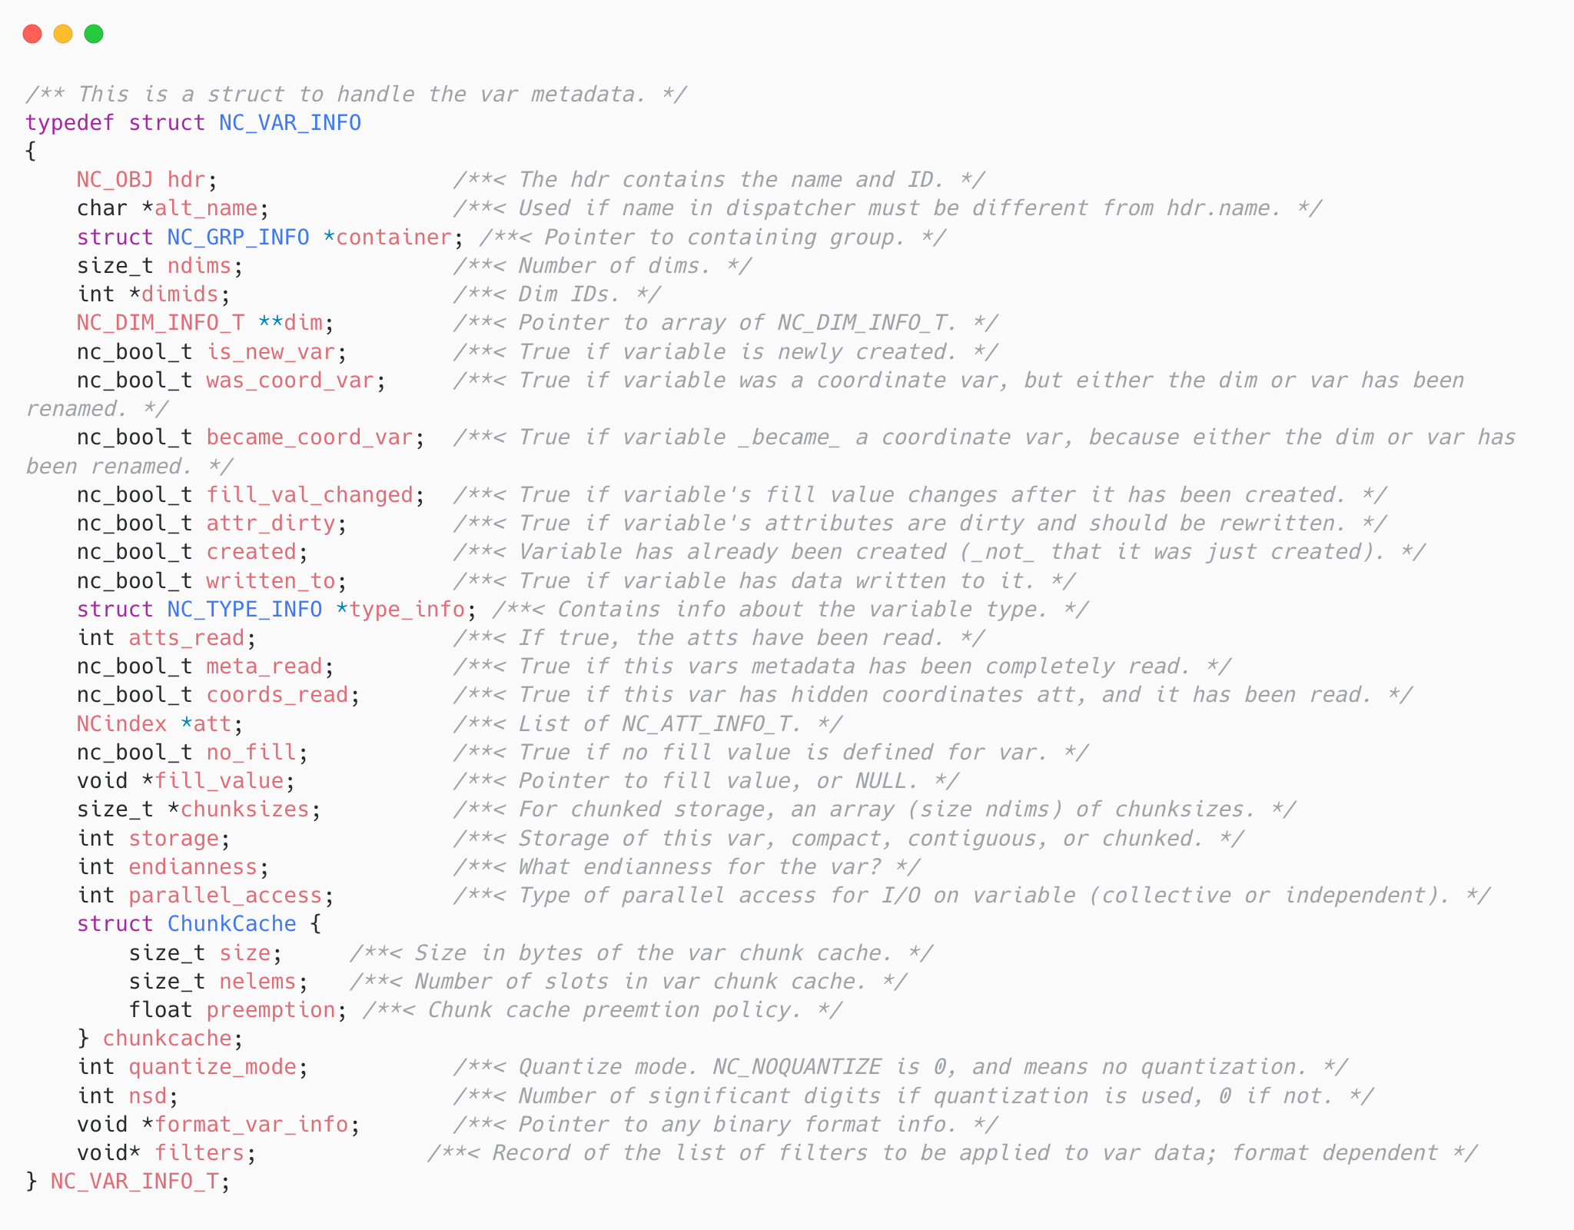
XIOS Modification
NC_VAR_INFO struct in NetCDF
NC_VAR_INFO struct store type_info, ndims, dimids, dim information that is required to perform SZ_compress without querying using NetCDF API call.

Slide 8
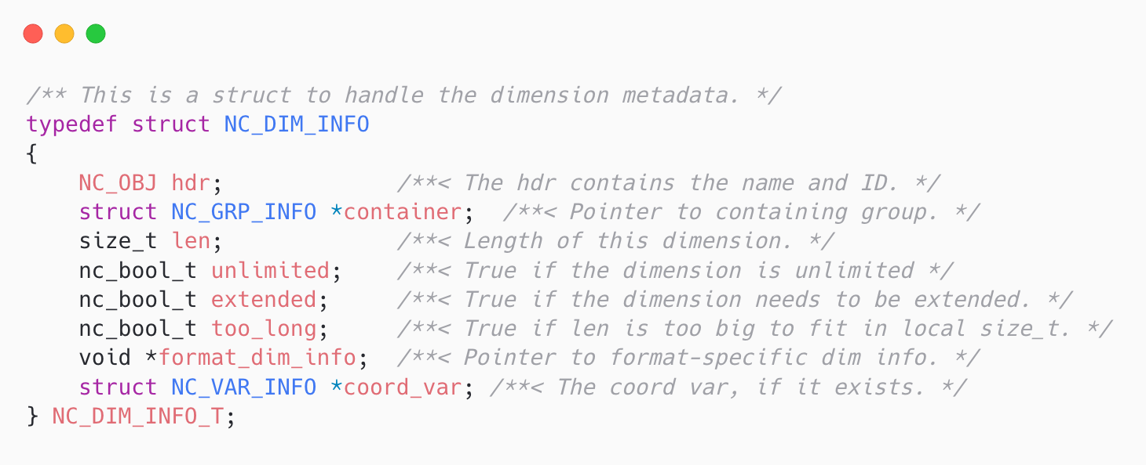
XIOS Modification
NC_VAR_INFO struct in NetCDF
NC_DIM_INFO struct dimension length and dimension type (unlimited dimension) without querying using NetCDF API call.

Slide 9
XIOS Modification
Updated Code Modification at libhdf5/nc4hdf.c in NetCDF library
Code modification related to metadata retrieval needs to be moved from libhdf5/hdf5var.c into libhdf5/nc4hdf.c.
Sending parameter implementation needs to be updated from nc_def_var_filter to H5Pset_filter in libhdf5/nc4hdf.c.
herr_t code = H5Pset_filter(plistid, fi->filterid,
#if 1
H5Z_FLAG_MANDATORY,
#else
H5Z_FLAG_OPTIONAL,
#endif
8, params);

Slide 10
Experiments
Tested the retrieval metadata modification with Toy program using NEMO model
The compression is successful for NEMO models with smaller dimensions
Filename | Filesize | Result | Description
cplfco.3h.foamlite.grid_T_0000.nc | 154 M | Segmentation Fault | Fail at e3t(8, 75, 166, 362) variable
cplfco.3h.foamlite.grid_T.nc | 306 M | Segmentation Fault | Fail at e3t(8, 75, 332, 362) variable
cplfco.3h.foamlite.grid_V_0000.nc | 6.3 M | Success | No issue for somecrty(8, 166, 362) variable
cplfco.3h.foamlite.grid_V.nc | 21 M | Segmentation Fault | Fail at somecrty(8, 332, 362) variable

Slide 11
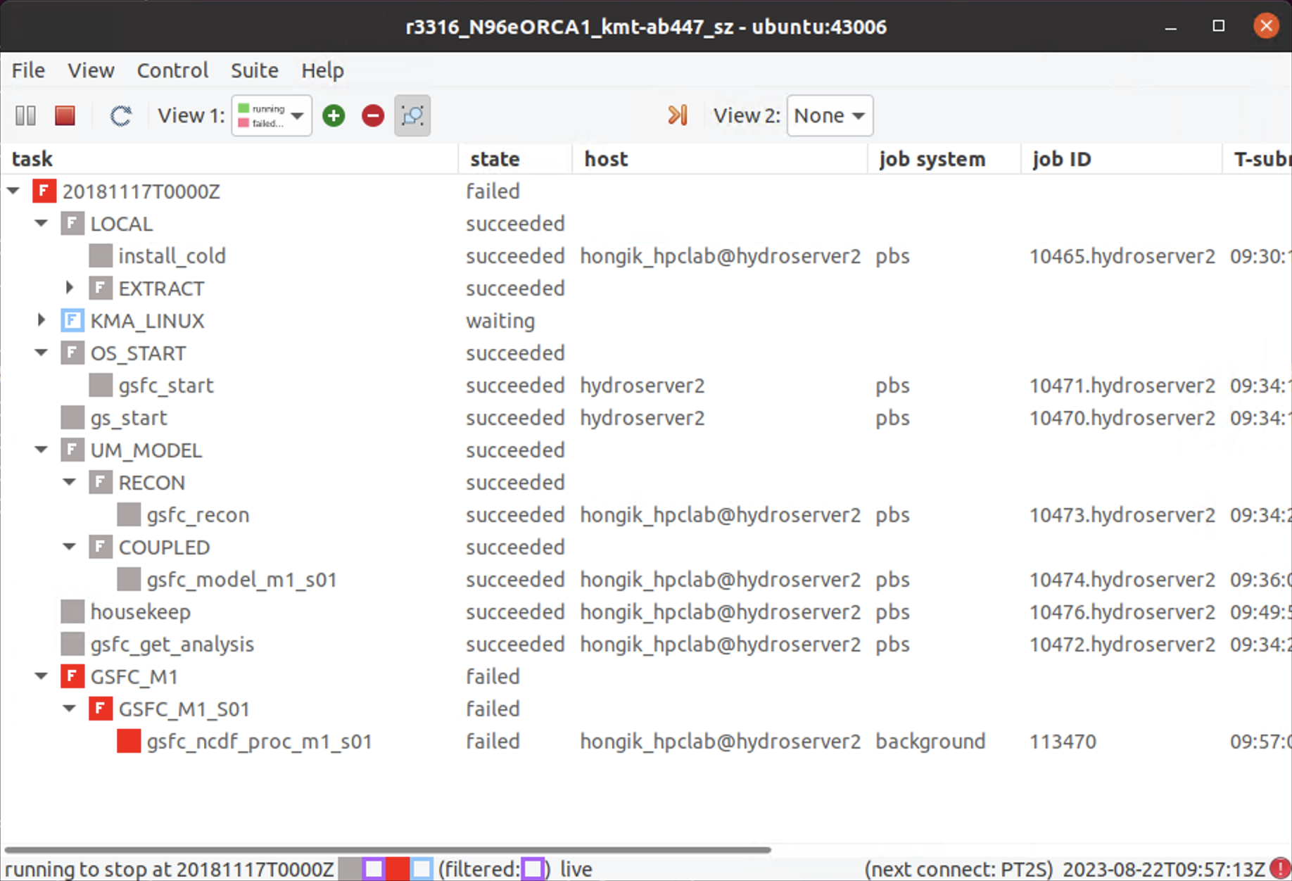
Experiments
Current experiment result for SZ filter approach
The experiment using attach mode with NEMO_NPROCX=4, NEMO_NPROCY=2
The gsfc_model_m1_s01 task is related to the SZ compression process. The task's state is successful which indicates no issue regarding the compression process.
However, the gsfc_ncdf_proc_m1_s01 is failed. The task is related to merging ocean output files.

Slide 12
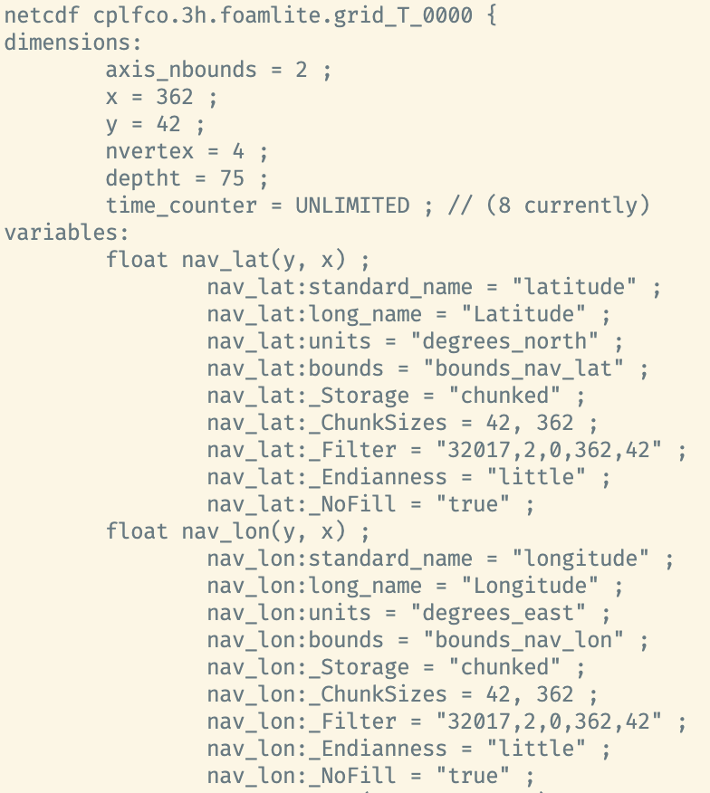
Experiments
NEMO models metadata temporary analysis
The _Filter key in variable attribute indicate the active filter -> SZ Filter.
The SZ filter previously have issue with the segmentation fault.
The issue have been solved may related to upgrading NetCDF4 from 4.7.3 to 4.9.2

Slide 13
Conclusion
An alternate way of retrieving metadata information, NetCDF provides NC_VAR_INFO and NC_DIM_INFO which store metadata information.
When compressing the large dimension variables, a segmentation fault has occurred. One approach solution is to break into smaller chunks before the compression process.
The SZ filter experiment has been conducted in detach mode, the result is successful for the gsfc_model_m1_s01 task. However, the gsfc_ncdf_proc_m1_s01 task failed when merging the ocean model output.

Slide 14
Action items
The next action depends on the Professor’s decision, which approach should be taken regarding the result of the experiments.

